Slide 1
S C H E D U L E
P R O G R A M
G U E S T A R T I S T
April 14, 2024
2023-2024
Jodi Keogan, an internationally acclaimed lyric soprano has enchanted audiences in Italy, the Bahamas, Ireland, France, the Philippines, and Germany. She captivates her audiences with music ranging from operatic arias to Broadway show tunes and the Great American Songbook. While her summers are spent performing in many senior living communities (outreach programs) in Connecticut and Naples, Jodi also directs and stages performances during summer concerts in local band shells and pavilions. Jodi also performs at country clubs and private communities in the tri-state area and Naples. Bookings can be made at loni@kollermarketinggroup.com or by calling 303-818-9600.
Sunday, October 15, 2023
”Fiesta” featuring
Maritza Cedeño & FloDivinas Dance
Naples New Horizons Band
Sponsored by Ken and Carol Carper
Sunday, November 12, 2023
“With Liberty for All” featuring Doug Renfroe
Christmas in July
Sponsored by Bill Ricigliano
Sunday, December 10, 2023
”Joy to the World!” featuring Craig Greusel
Lighthouse of Collier, Inc.
Sponsored by The Miles Family
Sunday, January 14, 2024
“Cinemagic” featuring Heather Ivy - cancelled
Park Family & Cosmetic Dentistry
Sunday, February 4, 2024
“To Naples, With Love” featuring James Jones
Habitat for Humanity
Sponsored by Dr. Craig & Kathy Fenton
Sunday, March 3, 2024
“Americana Road Trip” feat. Vince DiMartino
Park Family & Cosmetic Dentistry
Saturday, March 23, 2024 (7:00 P.M.)
“Life is a Cabaret, Old Naples”
featuring Carolann Sanita
Naples Zoo
Sponsored by Dr. Craig & Kathy Fenton
Sunday, April 14, 2024
“American Dream” featuring Jodi Keogan
Sponsored by: Cadence Music
J. STEVEN MOORE, Music Director and Conductor
JOHN SALMINEN, Associate Conductor
MIKE REILLY, Announcer
BUD GARTLAND, President
TODD HANDLEY, Vice President
FRED BURNS, Treasurer
CAROL CARPER, Secretary
For Starters . . . . . . . . . . . . . . . . . . . . . . . . . . Gene Davis
Dramatic Fanfare No. 1 . . . . . . . . . . . . . . . Morton Gould
Star Spangled Banner . . . . . . . . . . . . . Francis Scott Key
arr. Wm. Pruyn
American Overture for Band. . . . Joseph Willcox Jenkins
My Fair Lady . . . . . . . . . . . . . . . . . . . . . Frederick Loewe
Jodi Keogan, vocalist
NCB March (Paradise Found) . . . . . . . . . . Malinda Zenor
Medley from Miss Saigon . . . . . . . . . . . . . . . Alan Boublil
arr. Warren Barker
Since 1972
J. Steven Moore
Conductor
John Salminen
Associate Conductor
featuring
Jodi Keogan
Sunday, April 14, 2024 2:00 PM
Cambier Park Bandshell
Intermission
Dancing in Air . . . . . . . . . . . . . . . . . . . . . . . . . . . Yo Goto
John Salminen, conductor
Phantom of the Opera . . . . . . . . . . Andrew Lloyd Weber
arr. Warren Barker
John Salminen, conductor
Scholarship Presentation
The Sound of Music . . . . . . . . . . . . . . . Richard Rodgers
arr. Robert Russell Bennett
Jodi Keogan, vocalist
The Impossible Dream (The Quest) . . . . . . . Mitch Leigh
arr. Rob James
Jodi Keogan, vocalist
Next Concert
SUNDAY, NOVEMBER 10, 2:00 PM
All concerts are in Cambier Park. In the event of inclement weather, please check the website.
WWW.NAPLESCONCERTBAND.ORG
Suggested $10 donation per person
We rely on your support for today’s concert.
“Keep the music playing” for years to come!
Bucketeers needed!
Sign up at the front table or call 239-270-1221
Want to become a band member? auditions@naplesconcertband.org

Slide 2
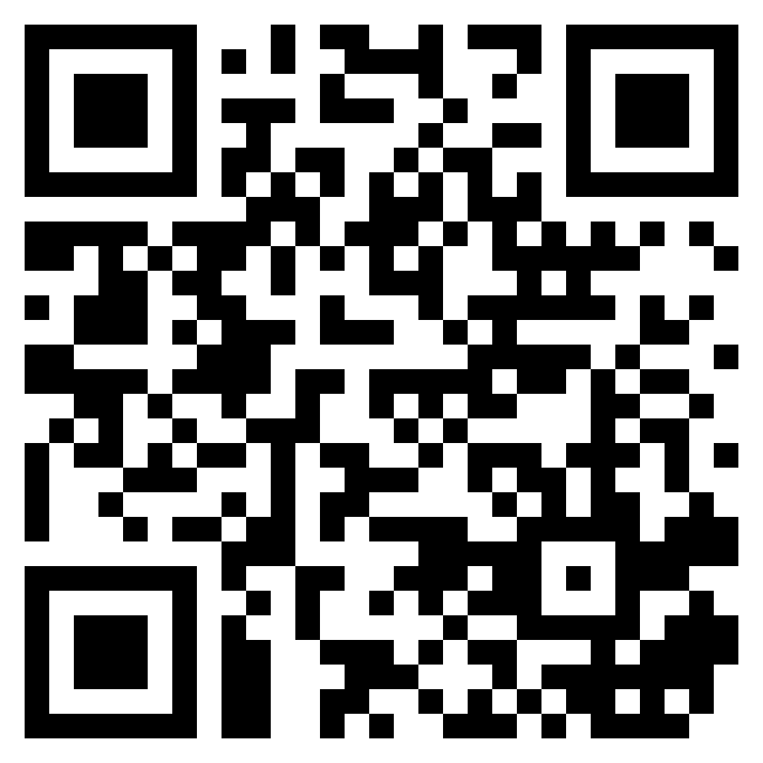
S P O N S O R
P E R S O N N E L
T H A N K S
FANS OF THE BAND: $100 - $249 (cont.)
NOTE: The list below includes donations we have received 14 business days prior to our concerts. If you have sent a donation and it is not listed below, it is likely due to the timing of receipt of your donation and our printer deadlines. Please accept sincere apologies if your donation is missing–we will do our best to make sure it is in our next program.
Dr. Edward & Mrs. Katherine Kvet Mary Jo Luth Scott Macdonough Judith Magdziarz Rosylynn & David Malarek Carol Matyniak & Larry Hotland Fran & Tom Mehelich Joel Miller Frank & Lucille Mollo Danny & Kay Mullis C. Edward Neal Deborah & James Nordstrom Warren & Lois Opel Don Peacock Frank & Charlotte Pichler Bentley Pierce | Sam Pinyuh Ellen Radomski Charles & Shirley Sachs Drs. Bob & Barbara Sadowski Roslyn Schneider & Ari Schneider Susan Shaffer-Bartley Gary Smith Jan & Keith Smith Frank & Judy Sower Dr. Paul & Ms. Gerry Sweterlitsch Terry & Carol Tobin Patti Kelly & Jim Van Cleef Gerald Weis Roberta & Joel Wise Ken Wistrom
Piccolo Julie Meschko (SL) Flutes Cathy Bumbledare Robin Engelson Elizabeth Parker Ana Peña ​Linda Picone Cindy Quehl Cherry Smith Sandy Stein Oboes Sue Adney Dianne Ritz-Salminen ​ Clarinets Janet Blumert Bill Brasile Diane Brennan Ann Brown George Brown Frank Burgeson Amanda DeCastro Valerie Esnes Anna Fernald Karen Marcotte-Eckler Marilyn Perry John Salminen Jim Stahl Talia Stasiowski Lorraine Wistrom (SL) Bass Clarinets Jennifer Morgan Richard Wessler | Alto Saxophones Matthew Csontos Don Fabiano Tim Hains Catherine May Tenor Saxophones Jeff Ricigliano Bob Smith​ Baritone Saxophone Lou DeBonzo Mykala Ricigliano Trumpets Jim Castaldi Kathy Kvet (SL) Nancy Lachance Harris Lanzel Dave Metzler Jim Nordstrom Terry Stevens Norm Taylor Mary Zitnik ​Horns Carol Carper Mike Donovan Dave Drewek (SL) John Grover Jan Lane Paul Myerson Kelly Parker ​William Parker (SL) Section Leader (S) Student | Trombones Gene Bartley Connie Cappelli Jerry Huckle Curt Kumpf (SL) Melanie McLean Matt Murrell Denny Viers Euphoniums Everett Hughes David Jackson ​Ken Wistrom (SL) Tubas Larry Butkus Jeff Deane Bud Gartland Alexa Strom (S) Double Bass Troy Miles Percussion Dave Aulenbach Cole Ellis (S) Jameson Moore (S) Phyllis Olex Rob Platter (SL) Teresa Ricigliano (S) Associate Conductor John Salminen Conductor J. Steven Moore
VIRTUOSO SPONSOR $5,000 +
MUSICIAN SPONSOR $2,500 - $4,999
Anonymous
Dr. Craig & Kathy Fenton
Everett J Hughes
Nelson & Susan Smith
ANNOUNCER SPONSOR $1,000 - $2,499
Sue & John Adney
Margie Belaney
Susan Belaney
William M. Bennett
Elaine T. Hampton
Richard Holmes III
Janice Jack
Harris & Judy Lanzel
Mary Ann Novak
Nelson M. Smith Jr.
Although we are grateful for all contributions, please note that there is a minimum donation of $100 to be listed on the program. Additionally, donations will be listed for 12 months from time of donation.
PERFORMER SPONSOR: $500 - $999
James & Connie Cappelli
Susan Ciaramella
Joe & Annette Duffy
Paul Myerson & Giselle Wagner
Judith Neely & Doug Renfroe
Lee & Marilyn Perry
Special Thanks
City of Naples for their support and designation of the Naples Concert Band as a cultural institution.
Black Tie Tuxedos, 15200 S. Tamiami Trail, Fort Myers, sponsor of J. Steven Moore’s conducting attire. With over 5000 tuxedos on premises, they are your locally-owned shop to rent or purchase suits for rehearsal dinners, honeymoons, cruises, and events.
FRIENDS OF THE BAND: $250- $499
David & Susan Drewek Mike & Eileen Reilly
John R. Karickhoff, M.D. Lorrainne Schapiro
Bud & Claudia Luppino Mary Zitnik
Cadence supports MFGN
FANS OF THE BAND: $100 - $249
Cadence Music proudly supports the work of the Music Foundation of Greater Naples (MFGN), and encourages you to support their work in the community.
MFGN supports music education and performance, provides scholarships to students, and engages in collaborative outreach efforts within Naples and its neighboring communities.
You may support to the Foundation at the following address:
Music Foundation of
Greater Naples
P.O. Box 112383
Naples, FL 34108
Joyce Albro
John & Barbara Beach
Timothy Bell
Lief & Patricia Birkeland, Jr.
Larry & Dottie Bowers
Bill Brasile
Ann & George Brown
Frank Burgeson
Dennis & Adianne Cady
Connie Caravasos
Jan Caruso
Mark & Patty Chodosh
Joe Choomack
Bob & Betsy Coll
Richard & JoAnne Collins
Blane & Doshie Crandall
Brad & Diane Cromwell
Gwen DeWitt
Thomas & Judith Diederich
Tim & Amy Driscoll
Karen Marcotte & Fred Eckler
Bill & Jewel Eckstrom
Frank D Englund
Valerie and Thomas Esnes
Dick Evans
Bruce Fernald
John & Joanne Flaherty
Charles France
Vicki & Bud Gartland
Sue Gartland
Jerry & Diane George
Mark Gerber
Gary Grabowski
Julieanne & Dan Grace
Kathleen Griffin
Judy & Tom Haevers
Todd Handley & Catherine May
Ruth Hatch
Robert Herrema
Fred & Pam Hirschfeld
Jeffrey & Patricia Hoffer
David & Sally Jackson
Manford & Victoria Jerome
Peter & Brenda Kanarian
Albert & Diane Kaneb
John & Mary Kiely
Jeff & Beth King
Each star on a member’s uniform indicates 5 years of service.
S U P P O R T T E A M
Donate Online!
Open your smartphone’s camera, focus on this symbol and press the link that appears on your phone screen. Easy!!
Announcer Mike Reilly Librarian Dianne Ritz-Salminen Scholarships Linda Picone Membership John Salminen Band Manager Bud Gartland | Property Manager Fritz Belance Fan of the Band Coordinator Susan Drewek Grant Writer David Drewek Sound Engineer Keith Scott Tutti Editor Ken Carper Webmaster Todd Handley | Audition Contact Lorraine Wistrom Auditions Ana Peña Ken Wistrom Concert Program Cathy Bumbledare Treasurer Fred Burns Marketing Loni Koller

